Slide 1
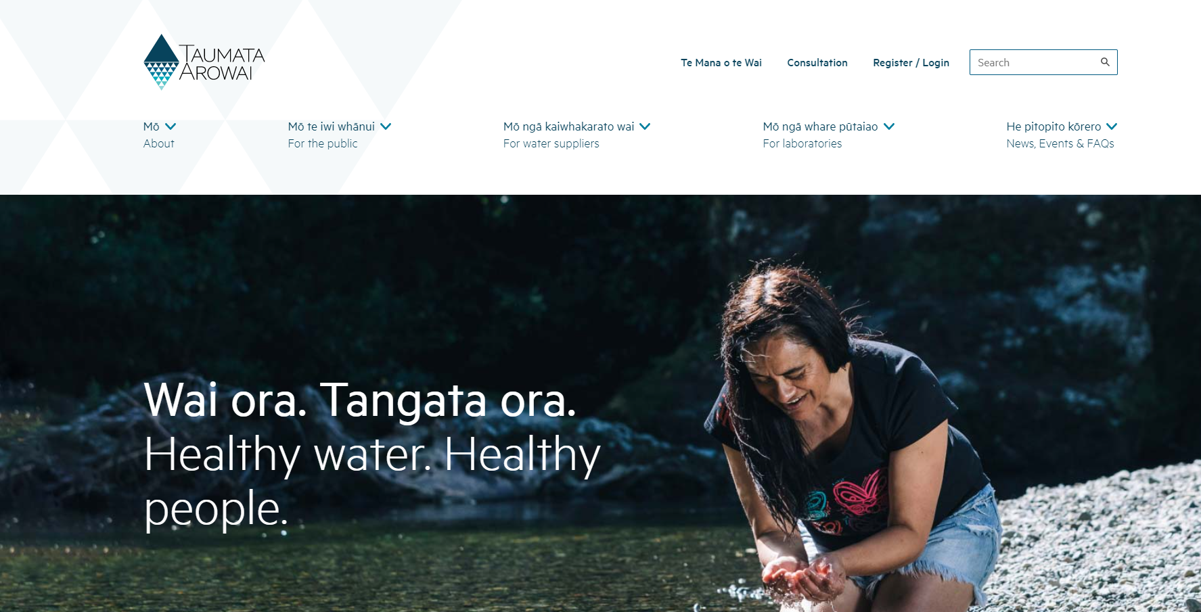

Slide 2
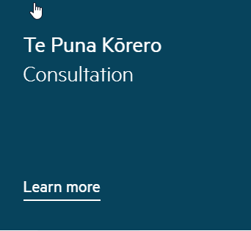

Slide 4
Purpose of this Act (Water Services Act 2021)
(1)
The main purpose of this Act is to ensure that drinking water suppliers provide safe drinking water to consumers by—
(a)
providing a drinking water regulatory framework that is consistent with internationally accepted best practice, including a duty on drinking water suppliers to—
(i)
have a drinking water safety plan; and
(ii)
comply with legislative requirements (such as drinking water standards) on a consistent basis; and
(b)
providing a source water risk management framework that, together with the Resource Management Act 1991, regulations made under that Act, and the National Policy Statement for Freshwater Management, enables risks to source water to be properly identified, managed, and monitored; and
(c)
providing mechanisms that enable the regulation of drinking water to be proportionate to the scale, complexity, and risk profile of each drinking water supply.

Slide 5
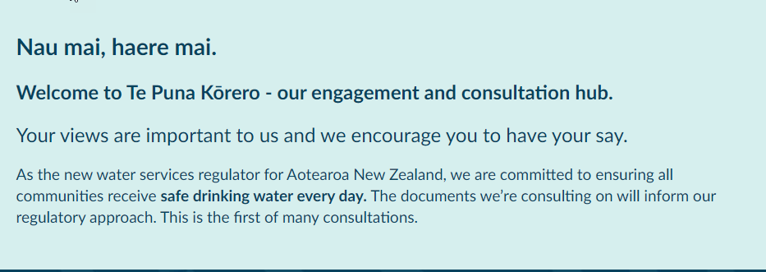

Slide 6
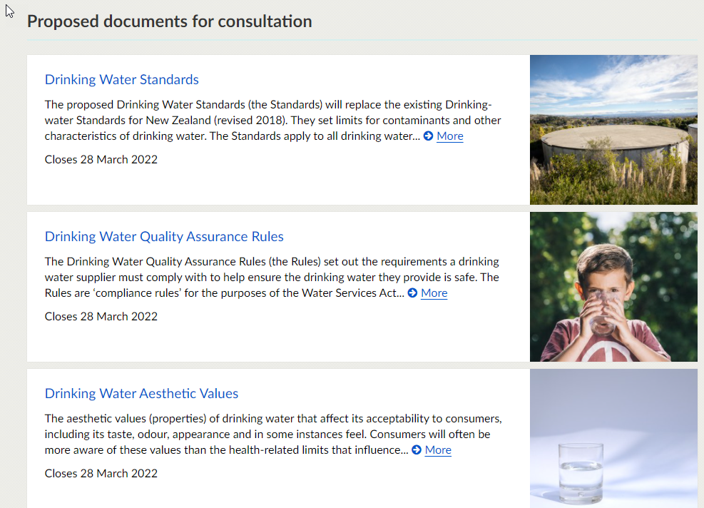

Slide 7
The Standards
Setting limits for:
MAVs for Microbiological Determinands
MAVs for Inorganic Determinands
MAVs for Organic Determinands
MAVs for Radiological Determinands

Slide 8
Drinking Water Quality Assurance Rules
Requirements a drinking water supplier must comply with to help ensure the drinking water they provide is safe
The Rules are categorised into different drinking water supply types
On demand networked drinking water supplies
Trickle feed water supplies
Self-supplied building drinking-water supplies
Water carrier service
Planned Event Temporary Drinking Water Supplies
Community drinking water station/water carrier supplies

Slide 9
Drinking Water Quality Assurance Rules
The new Rules apply to all drinking water supplies that serve more than a single domestic dwelling. This reflects the increased scope of the Water Services Act 2021 (the Act).

Slide 10
The Rules are based on the following drinking water supply categories and associated population sizes
1.On-demand Networked Drinking Water Supplies
< 50 consumers (Very Small Supplies)
50 – 500 consumers (Small Supplies)
>500 consumers (Large Supplies)
Varying Population Size Supplies
2. Trickle Feed Water Supplies
3. Self-supplied Building Drinking Water Supplies
<50 drinking water consumers
>50 drinking water consumers
4. Water Carrier Services (any population size)
5. Planned Event Temporary Drinking Water Supplies (any population size)
6. Community Drinking Water Stations / Water Carrier Supplies (any population size)

Slide 11
Key changes from the old Drinking -water Standards for New Zealand
different levels of complexity to cater to the diversity of drinking water supplies
a new format to make it easier for suppliers to find the rules that apply to their supplies
a greater emphasis on testing to identify and help manage risks
new requirements for source water testing and distribution system monitoring
a new requirement to include a Source Water Risk Management Plan as a component of a Drinking Water Safety Plan
discontinued the DWSNZ Revision 2018 secure bore water criteria. All water supplies will need some form of treatment unless an exemption is granted by Taumata Arowai
a new chemical compliance section for large (>500 people) supplies.

Slide 12
Increased emphasis on identifying and managing risks
All suppliers (except those using an Acceptable Solution) need to provide a Drinking Water Safety Plan outlining how they will meet the requirements laid out in the Rules.
They also need to perform a thorough assessment of the risks across their whole drinking water supply system from the source to the tap. This risk assessment may identify other contaminants not covered by the Rules or the Standards.
Suppliers need to provide details on how they will monitor and manage these risks in their Drinking Water Safety Plan.

Slide 13
Rules are grouped into modules to make it easier for suppliers
Rather than reading through extensive chapters, each drinking water supplier is assigned a small set of modules containing the rules that apply to them.
There are general rules (G) that all suppliers need to follow.
There are rules that apply to different sizes or complexity of supply:
1 = simple
2 = moderate
3 = complex
There are rules that apply to different parts of the system:
Source water (S) rules relate to the process of extracting water.
Treatment (T) system rules relate to the process of treating water
Distribution (D) system rules relate to the networks and pipes used to distribute water to consumers

Slide 14
Within each module there are two types of rules:
Monitoring and reporting rules ensure that water supplies are complying with the Drinking Water Standards.
Assurance rules outline actions that a water supplier needs to undertake to ensure the safety of water. For example, the preparation of a backflow prevention programme to stop contaminated water re-entering the network.

Slide 15
Key changes to the Rules Source water
All source waters must be monitored for a range of parameters.
Source waters for Level 3 (complex) supplies are classified into four categories to determine the level of protozoa treatment that is required.
There are more specific requirements to prevent surface water entering bore heads.

Slide 16
Key changes to the Rules Treatment systems
We have updated the list of treatment system types, removing those that are not applicable to current industry practice.
Chemical compliance Rules for complex drinking water supplies (T3) are now assigned to supplies based on the statistical ‘Typical Value Method’. These values are used to determine monitoring periods for different chemical determinands in the source water.
We have added requirements for event-based monitoring to manage the risk to public health from rapid changes to the concentrations of contaminants in a water source or treatment plant.
We have added new cyanotoxin compliance rules based on risk categories of the source water.

Slide 17
Key changes to the Rules Distribution water
There are more rules for distribution systems, especially specific backflow prevention rules.
Residual disinfection will be compulsory unless an exemption is approved by Taumata Arowai, or a relevant Acceptable Solution is implemented.

Slide 18
Key changes to the Rules Monitoring
Drinking water suppliers must submit monitoring reports and data to Taumata Arowai in accordance with the monitoring period frequency requirements set out in the General (G) Rules.

Slide 19
Requirement Summary for Small water supplies
As a short sharp summary they are going to have to:
For populations less than 50
Monitoring 3, 6 monthly and annual and 5 yearly
Treatment – Filtering & UV
Qualified personnel
Backflow for moderate and high risk connections
Have an operational water safety Plan
Have a source water risk management plan (not sure about this for these v small supplies)
For populations 50 to 100
Monitoring Daily, weekly, Monthly & 3, 6 monthly and annual
Cyanotoxin monitoring
Treatment – Filtering & UV & chlorination
Qualified personnel
Backflow risk assessed annually
Have an operational water safety Plan
Have a source water risk management plan
Fluoridation???
Three Waters

